Slide 1


Analyzing Airbnb Reviews by Neighborhood
Michael Li

Slide 2
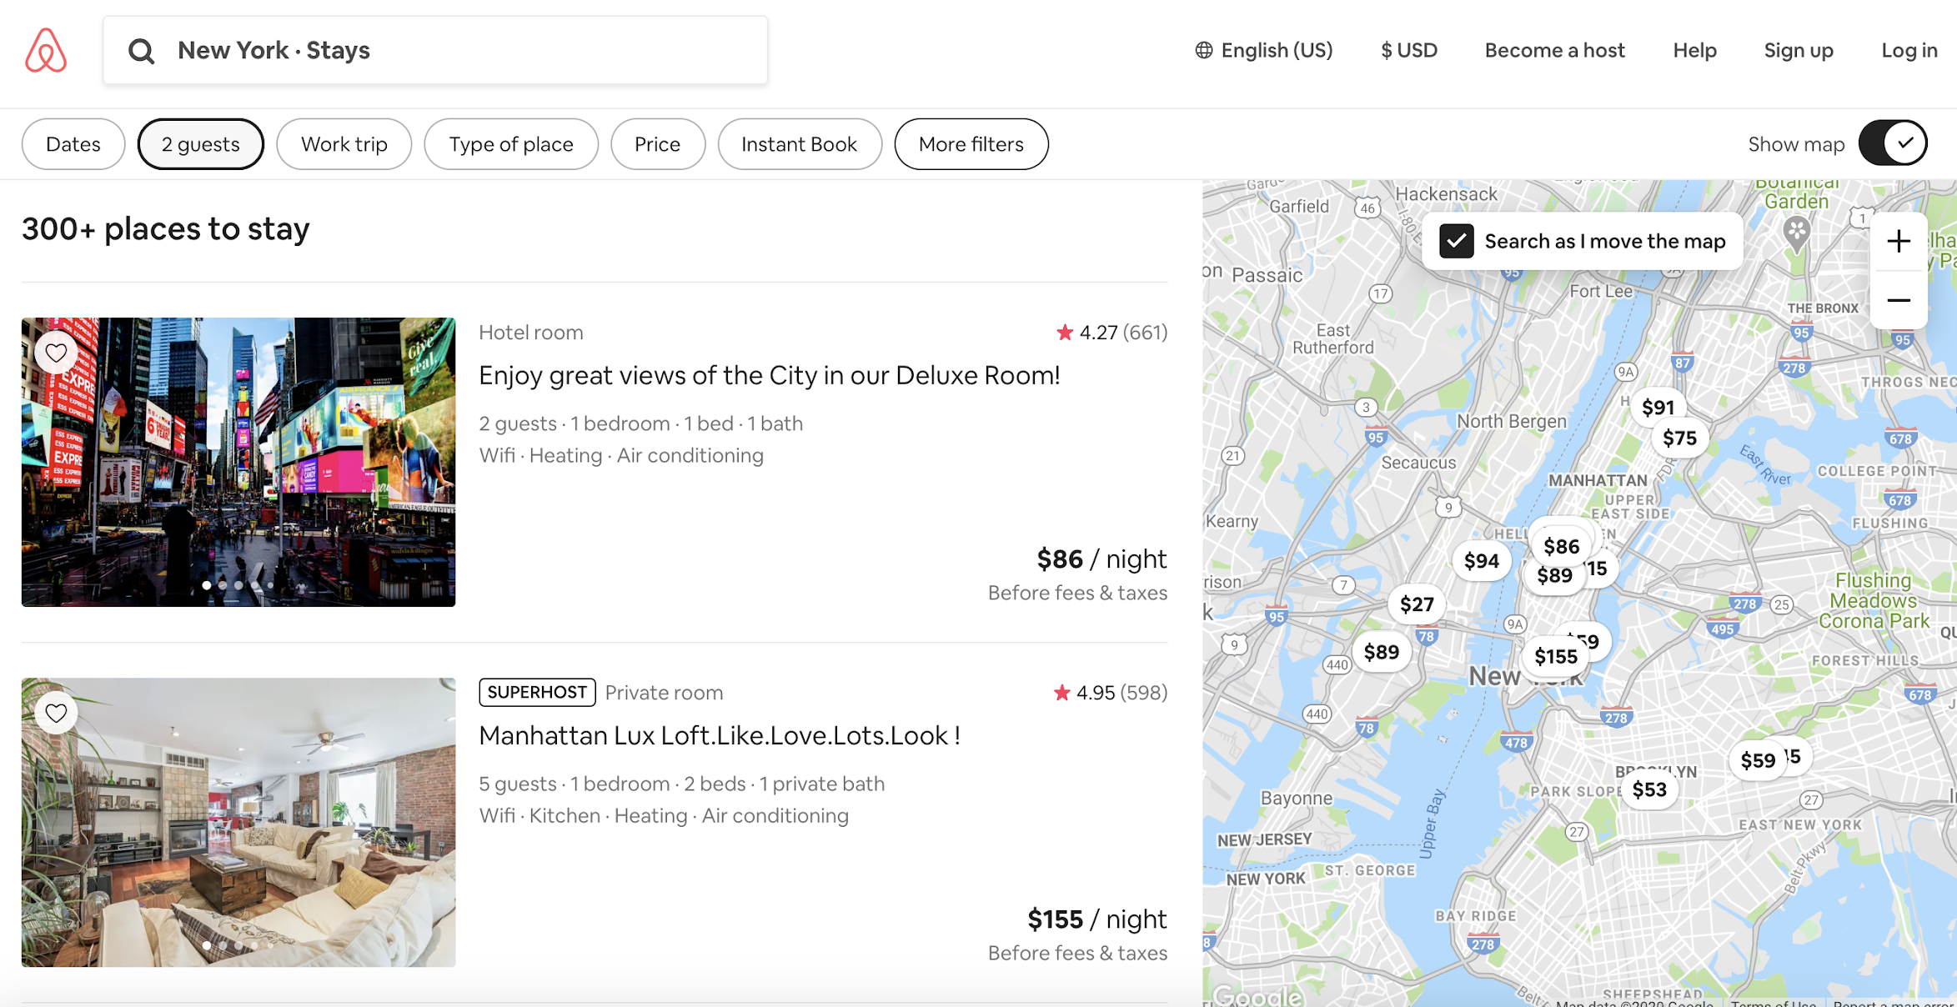
Current Search Capabilities
Filters
Filters can be applied to regions of interest to select locations that accommodate a certain number of guests or are within a certain price range.
Map
The map is a visual way to search locations; it displays the prices for each corresponding location and updates search results based on where the map is moved to.

Slide 3
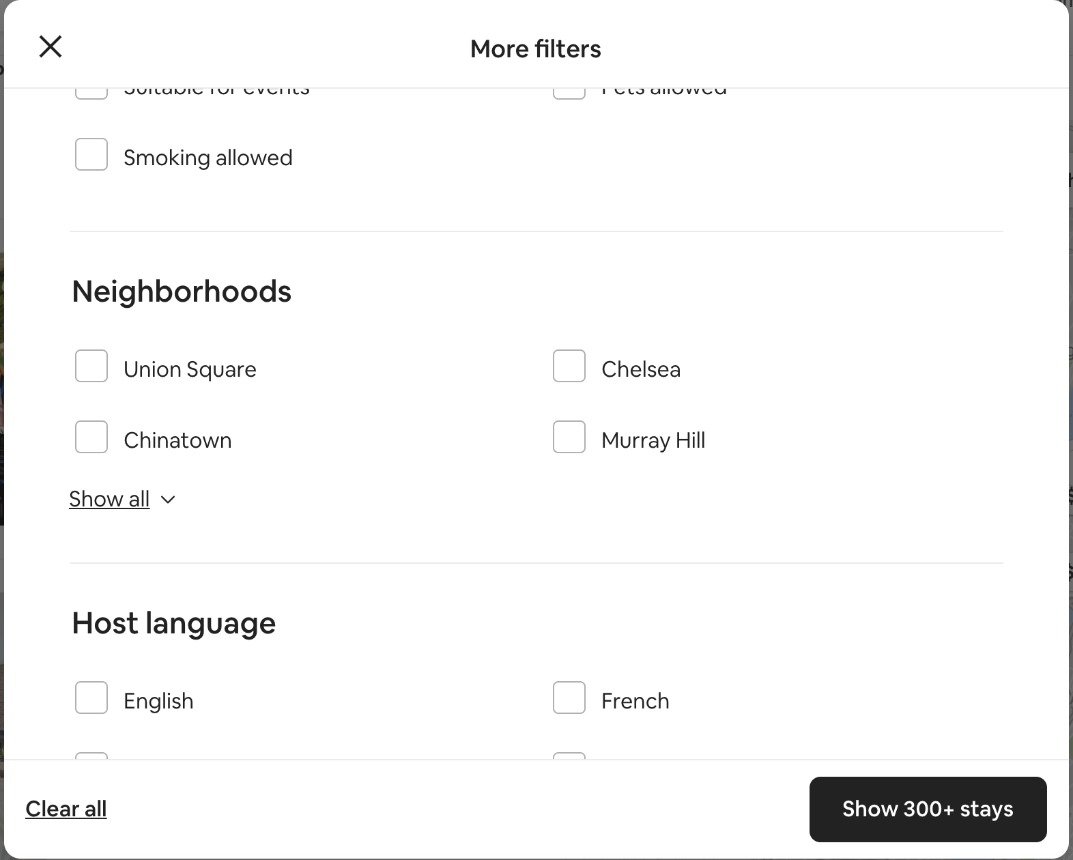
Neighborhood Search
Function
The neighborhood search is a way to filter Airbnbs by location. In New York City, it is a breakdown of the five boroughs into smaller regions within the city.
Usage
Most people who use Airbnb are tourists who might not be familiar with the city. As such, filtering by neighborhood is not often used as they lack the necessary information to judge which areas might suit their needs or interests. Unbeknownst to them, Airbnbs in different neighborhoods might differ substantially.

Slide 4
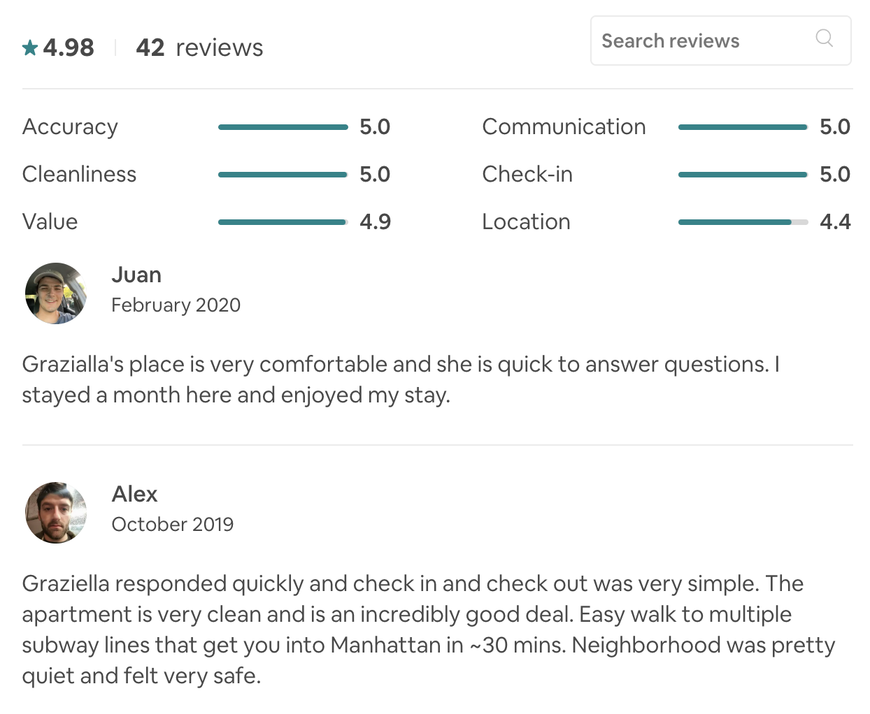
Airbnb Review Data
Reviews
Airbnb offers the opportunity for guests to leave reviews for each location they stay at. These reviews allow the guest to give a rating along with a comment about their stay.
Importance
Reviews are often an integral part of selecting an appropriate dwelling through Airbnb. Locations with a low rating or a few very critical comments could potentially dissuade guests from choosing an airbnb location.

Slide 5
Opportunity
Airbnb review data provides an opportunity to search through specific regions or neighborhoods by certain keywords.
Ex: searching neighborhoods for safety or noise level
Comment data provides a more thorough understanding of experience over superficial number ratings.
Natural Language Processing layers could be added on top to extract sentiment from these review comments.
Derive negative sentiment from neighborhoods
Filter out positive keywords and extract only negative keywords
Assign more accurate ratings based on review sentiment

Slide 6
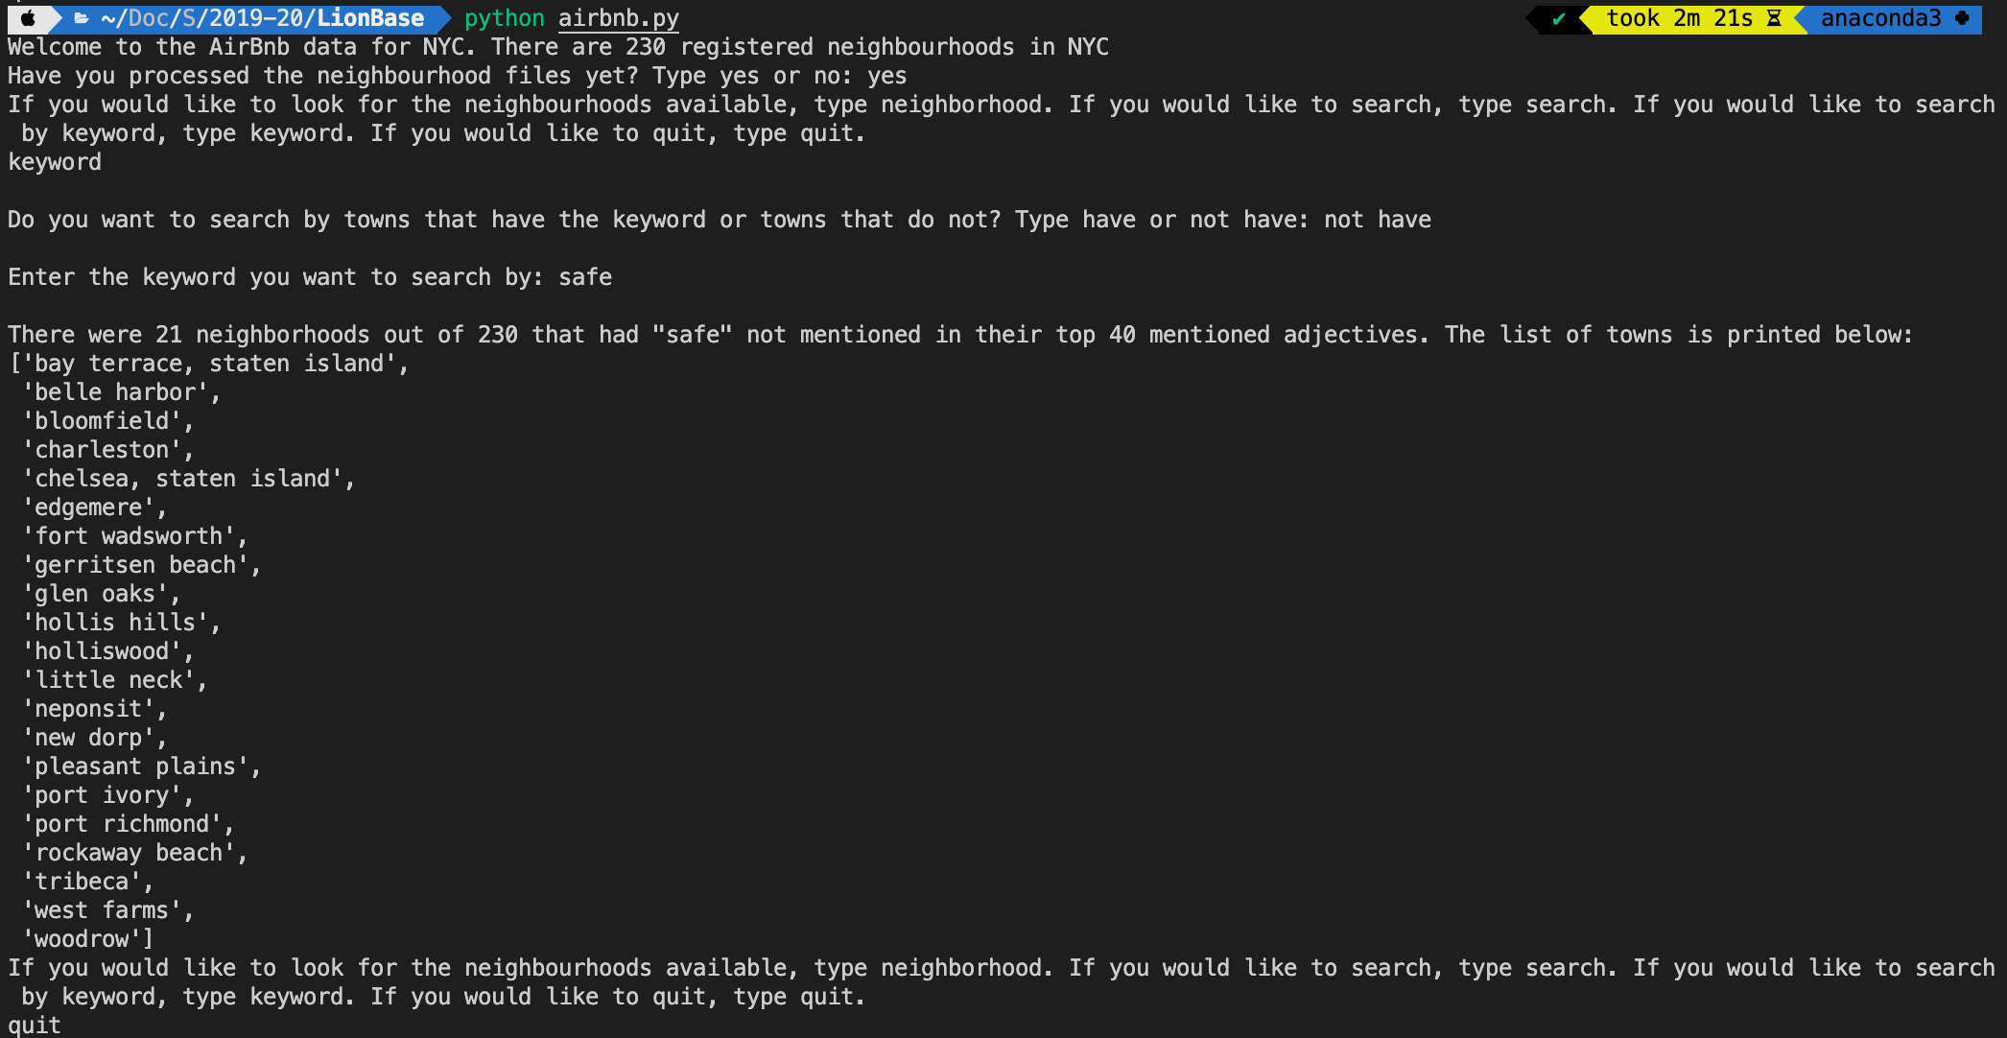
Possible Use Cases
Simple search
I wrote a program that can be interacted with in terminal to search for the top N keywords that appear in the reviews for Airbnbs in New York City and sort them by neighborhood. The search functionality allows the user to either search by the keywords or to search by the neighborhoods. Non-adjective keyword results were filtered out using python’s natural language toolkit (nltk).

Slide 7
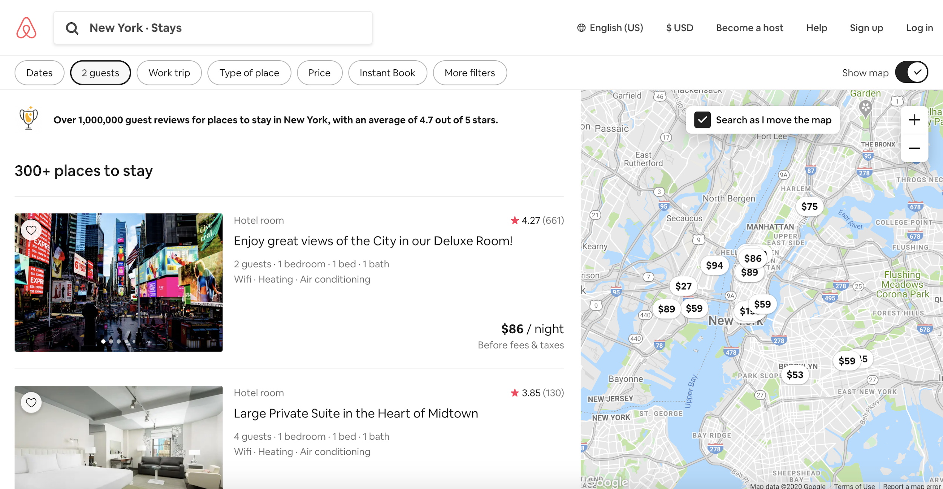
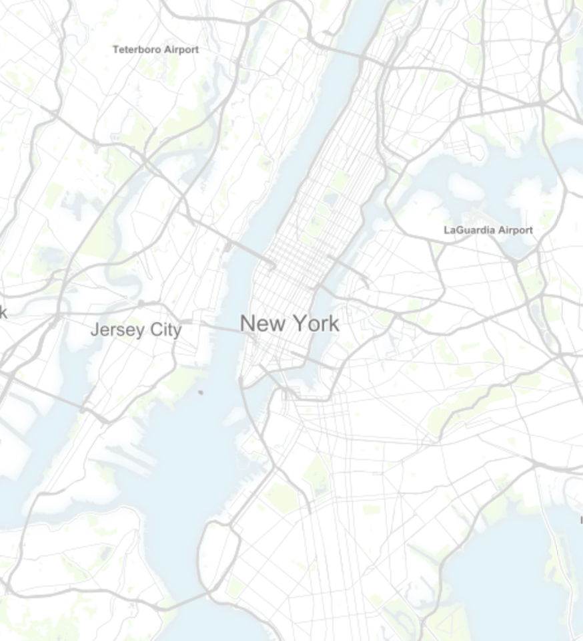
Advanced Use Cases
Map search
An interactive map could be used to display Airbnb listings that contain certain keywords. Listings could also be displayed by the most common keywords or complaints. This could be a much simpler way to give insight into neighborhoods generally, with neighboring Airbnbs possibly sharing traits.
Noisy
Safe
Clean
Hip
Boring

Slide 8
Conclusion
Airbnb accumulates a lot of data from guest reviews that can be parsed for keyword adjectives that describe stays in particular neighborhoods.
Airbnb could use this to allow prospective guests the opportunity to search for a place to stay based on the consensus of past neighborhood guests.
Further opportunities could come about through the addition of Natural Language Processing.

